Slide 1
Progress Report
Edward 施哨亮

Slide 2
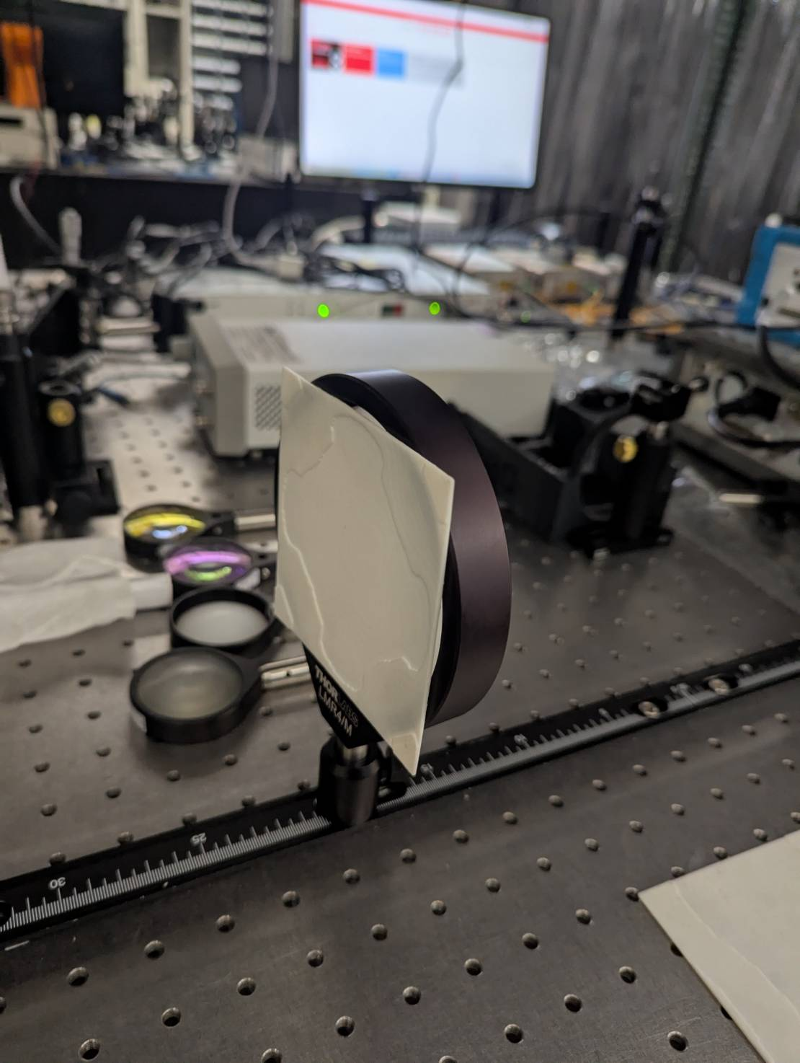
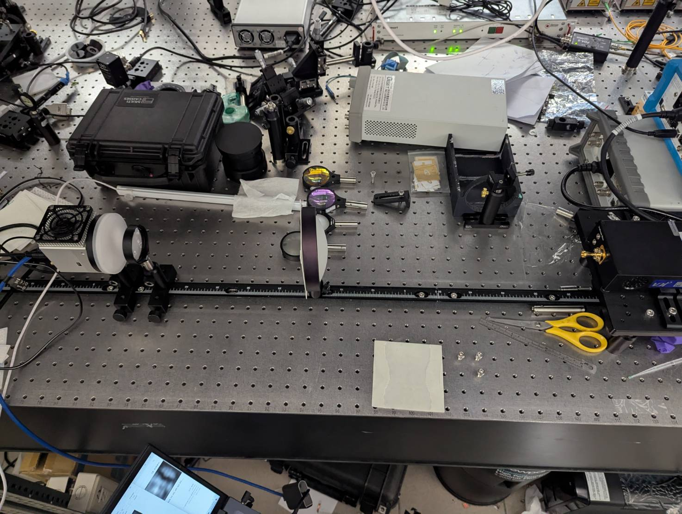
Real-life simulation
A simulation using the terahertz camera is done to test whether the 3D-generated phase plates are able to generate the image as the computational simulation showed.

Slide 3
Real-life simulation
The simulation parameter is set based on the best-generated image that can be captured by the terahertz camera (trial and error).
Final parameter:
Source to plate distance = ± 40 cm
Plate to camera distance = ± 28 cm
To ensure good focus on the camera, some lenses are also used

Slide 4
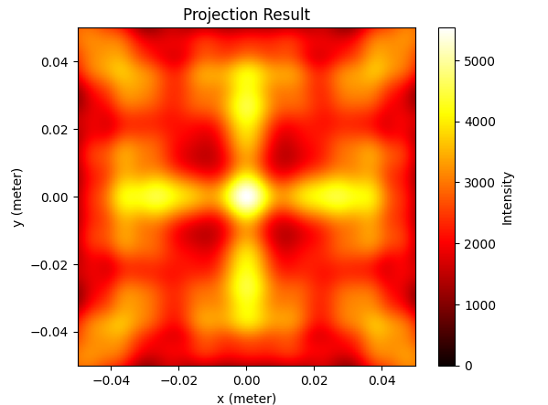
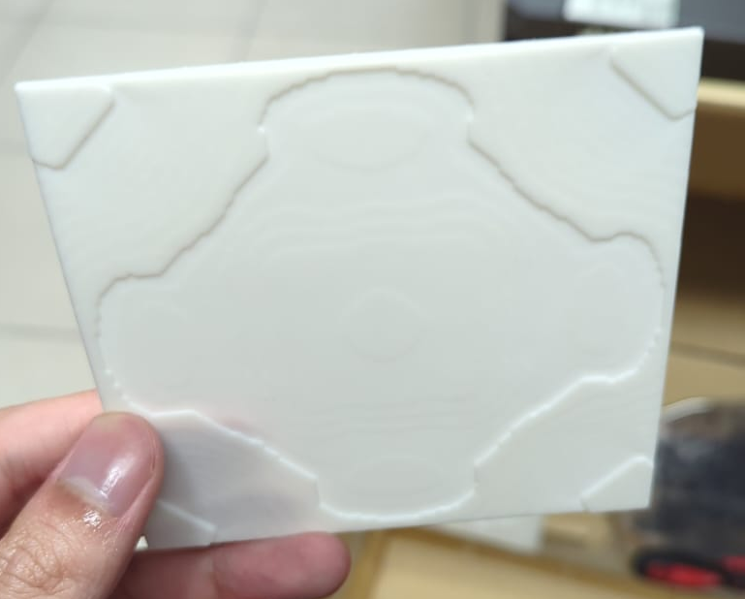
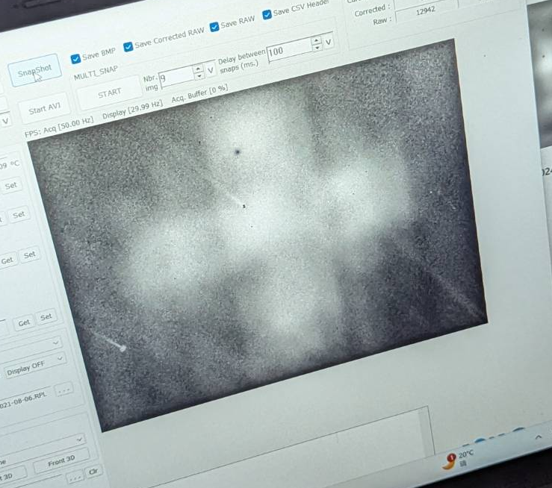
Results
Computer Simulation phase plate Real Simulation
Plus-shaped target:

Slide 5
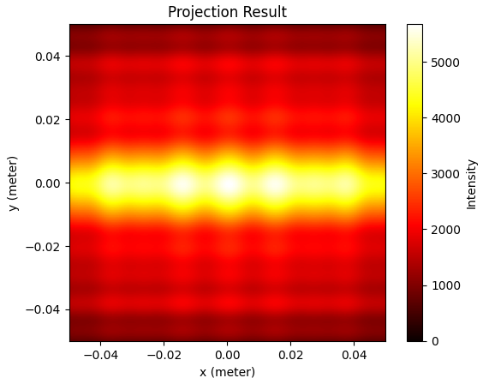
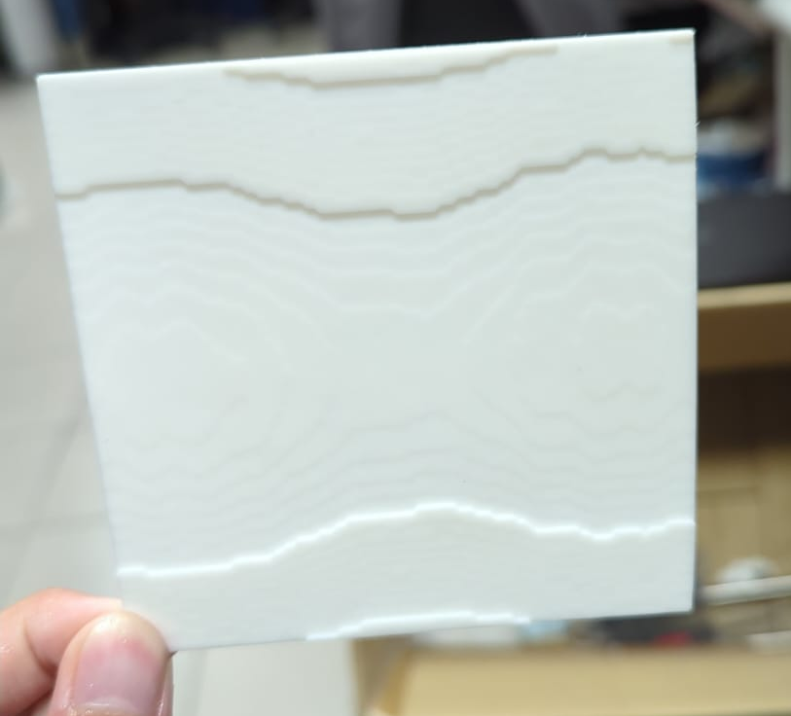
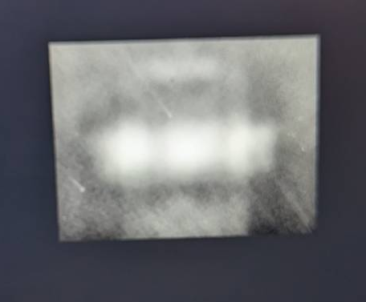
Results
Computer Simulation phase plate Real Simulation
Vertical line target:

Slide 6
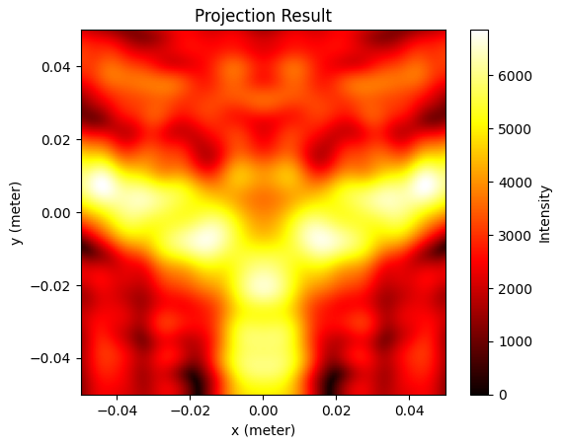
Other Results
Y-shaped target has also been done, with results resembling something similar with the simulation (the simulation photo is saved in the lab laptop)
A square-shaped target has also been simulated, but the results are not similar to the computer simulation. Another attempt for the square-shaped phase plate is re-calculated.

Slide 7
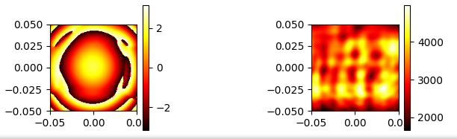
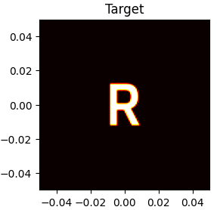
Other Results
Its do not converge to the target image; instead, it is stuck with the above results
This also happens with target G.
An attempt is still being made by changing the target image to make it easier for the plate to converge so that it can generate something similar to the target image.
A R-shaped and G-shaped phase plate has also been tried to be generated using the Gerchberg-Saxton algorithm. So far, the algorithm shows weakness due to a more detailed target image. (closer distance between the high-intensity point)
Target R:

